Slide 1
Explore wait times for priority procedures across Canada
DAB – 304 HEALTHCARE ANALYTICS

Slide 2
Contents
Team Introduction
Background
/motivation
Problem Statement
Project Proposal
Evaluation
Dataset Description and EDA

Slide 3
DAB – 304 HEALTHCARE ANALYTICS
GROUP - 016
1) Amir Dahya
2) Miloni Patel
3) Kawalbeer Kaur
5) Devkumar Patel
4) Pramit Parikh

Slide 4
Background/Motivation
Despite numerous notable advancements in healthcare sector, waiting time for priority procedures for Indigenous people still not efficiently resolved, they have to suffer from pain or chronic conditions. As a patient the first thing that comes to your mind is how long will you have to wait for your turn to get treated. It's no secret that Canadians often face longer wait times for medical procedures than patients in other developed countries. In fact, a recent study found that Canadians wait an average of 19.8 weeks for medically necessary treatments – that’s more than 4 months!
Notes:
Consider talking about:
Case Studies

Slide 5
Problem Statement
Better insights on the medical services available and number of patients for various medical treatment is needed by the Government of Canada and First Nations authorities. Moreover, COVID-19 restrictions in hospitals led to a backlog of procedures. Scheduled surgeries and other medical procedures were delayed several times as Canada’s health systems prioritized more-urgent treatments during COVID-19 waves. Delays varied by urgency of the surgery and clinical setting, as well as by jurisdiction.

Slide 6
Project Proposal
Our project team will create a descriptive analytics product which Explore wait times for priority procedures across Canada focusing on top priority treatments. It is unfeasible to simultaneously improve wait times for all treatments, we are aiming on priority treatment such as cancer, emergency surgery etc. we are focusing on identifies wait time difference and improvement in provinces across Canada for our identified top treatments. A deeper analysis will be done comparing pre-covid and post-covid wait times and its improvements and multiple dashboards will be presented to give insights into our findings. Moreover, using data analytics techniques on this data, we can identify possible major factors and medical services which should consider as the most prioritize one and we aim to reduce the waiting time for those services.
Notes:
Consider talking about:
Improving access
Reclaimed water
Purification
Global programs

Slide 7
From the data on the wait time procedures of Canada from the year 2008 to 2021, we want to classify them into two groups, pre-pandemic and post-pandemic to have more insights about the change or improvement in wait time. These are the milestones we wish to achieve: We aim to analyze waiting times (in days) at the hospital by province with respect to pre-pandemic and post-pandemic. ·We aim to analyze and see trends in the number of cases of specific treatment by top province-wise before COVID-19 and after COVID-19. Looking to improve the waiting time for cancer treatment, and cardiac treatment, diagnostic imaging, joint replacement at the hospital by interpreting the behavior of the data and representing it in a visualization to provide solutions for it.
Evaluation
Notes:
Consider talking about:
Contaminant Reduction through Policy & Market Improvements
Water treatment options

Slide 8
Dataset Description
The analysis is based on wait times for priority procedures across Canada dataset obtained from Canadian Institute for Health Information.
The data is basically based on historical wait time data, including national, provincial and regional data for the April 1 to September 30 period beginning in 2008. This file also contains additional October to March time periods for 2019–2020 and 2020–2021 to provide a comprehensive picture of wait times throughout the COVID-19 pandemic.

Slide 9
DATA Elements
The data set contains information on the following procedures:
Hip replacement
Knee replacement
Cataract surgery
Radiation therapy
Coronary artery bypass graft (CABG)
Computed tomography (CT) scan
Magnetic resonance imaging (MRI)
Cancer surgery (5 body sites: bladder, breast, colorectal, lung and prostate)

Slide 10

Data Analysis

Slide 11
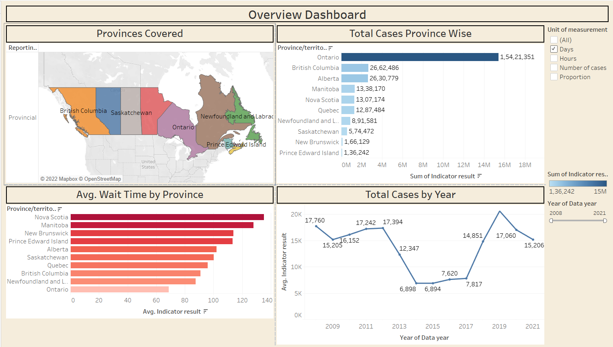
Dashboard 1

Slide 12
Dashboard 1 INSIGHTS
1. Dashboard one shows all the provinces covered throughout Canada, for this wait-time analysis project.
2. Based on the charts created, we can see the total cases including all high priority treatments, average wait times by province and distribution of total cases by year.
3. Based on this we can see that Nova Scotia, Manitoba and New Brunswick had the highest average in wait times when considering all priority treatments.
4. 2019 was the year with the highest amount of cases (20,637)
5. And further we can see that Ontario, British Colombia and Alberta were the top 3 provinces with the most number of cases.
6. Based on this we can already say that Nova Scotia, Manitoba and New Brunswick are very behind in the benchmark race and considering the comparison of number of cases in each province their wait time averages are too high.

Slide 13
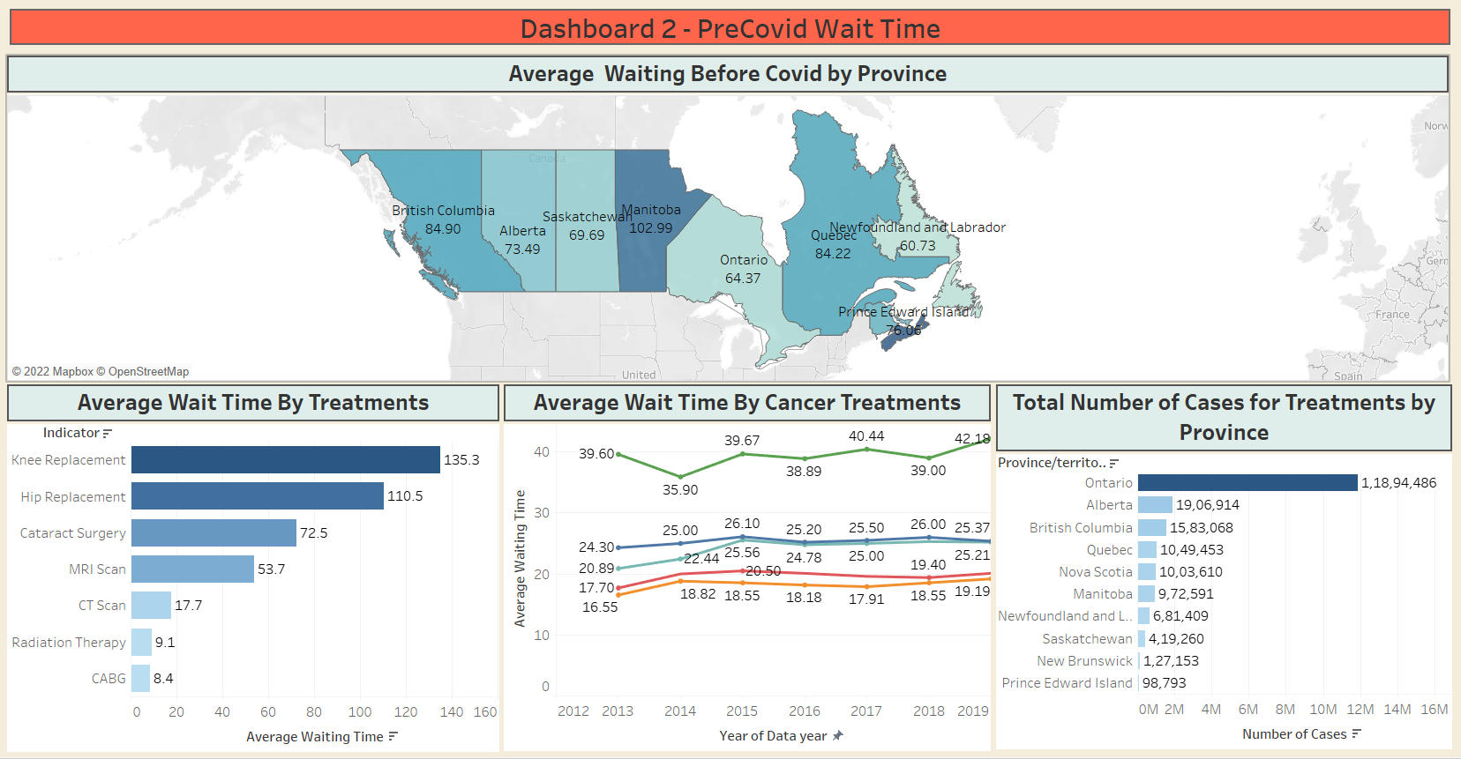
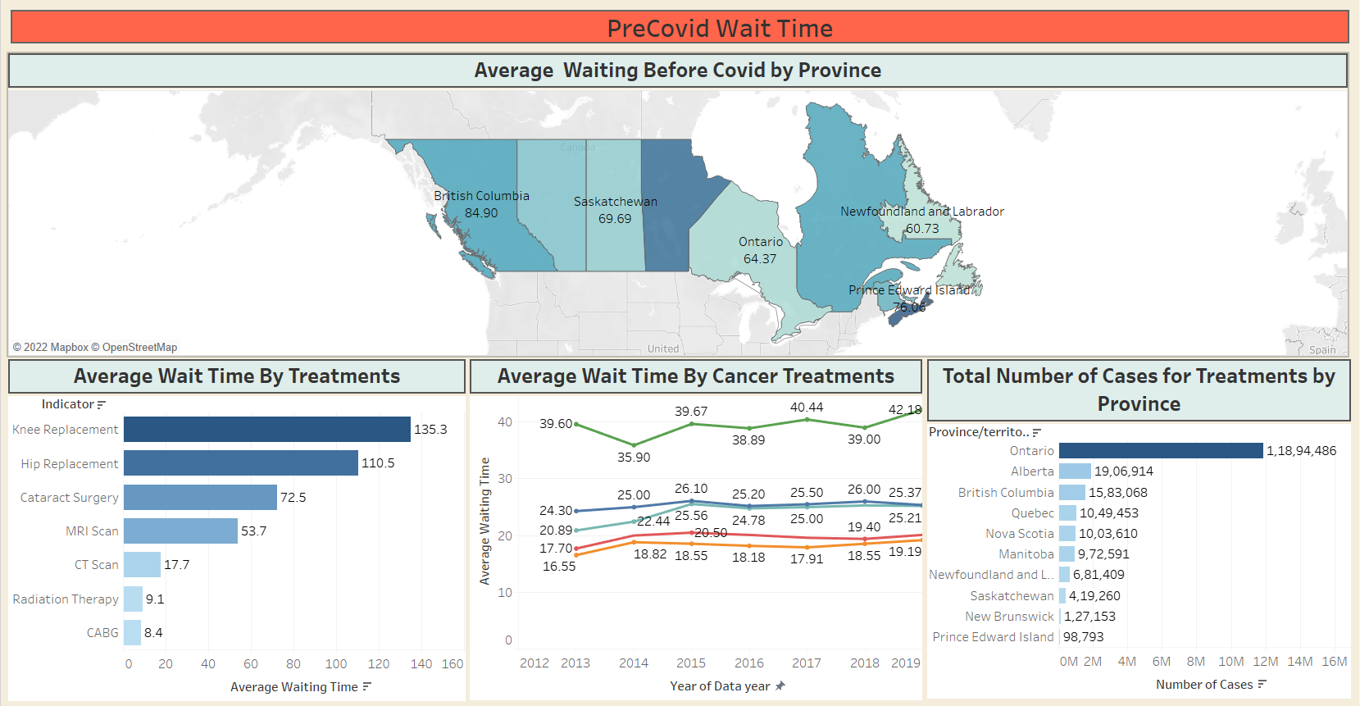
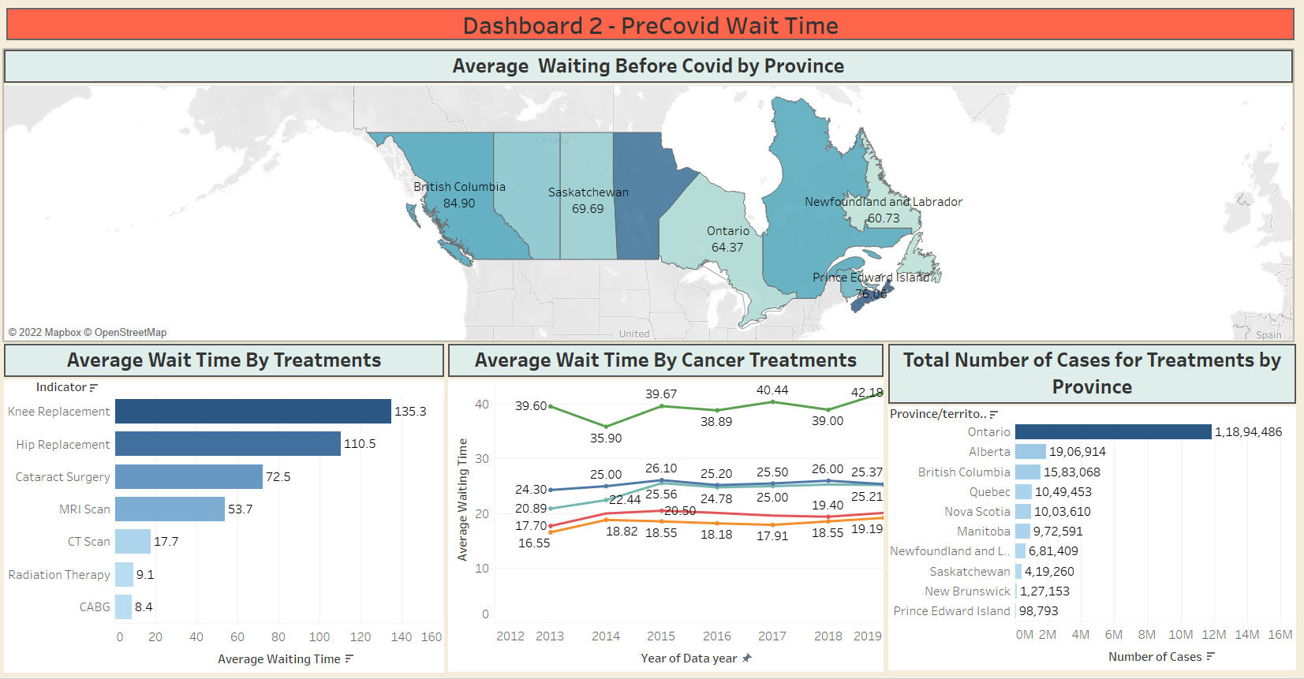

Slide 14
DASHBOARD 2 INSIGHTS
This dashboard goes deeper into filtering data by a timeline.
We’ve filtered data into two segments between dashboard 2 and 3/
Dashboard 2 shows average waiting times by province, treatments and cancer treatments pre-Covid.
The 2019 Novel Coronavirus was officially declared a public health emergency on January 31st 2020, and so that date has been used to split dashboard 2 and 3 into two segments, pre-Covid and post-Covid.
Considering Cancer treatments separately, we can see that Knee Replacements, Hip Replacements and Cataract surgeries had the highest average wait times before Covid.
Manitoba had the highest average wait time before Covid when it comes to provinces, followed by British Colombia, Quebec and Prince Edward Island.
We’ll compare the increase in wait times post covid and see which provinces and treatments need to be focused on more to improve wait times.

Slide 15
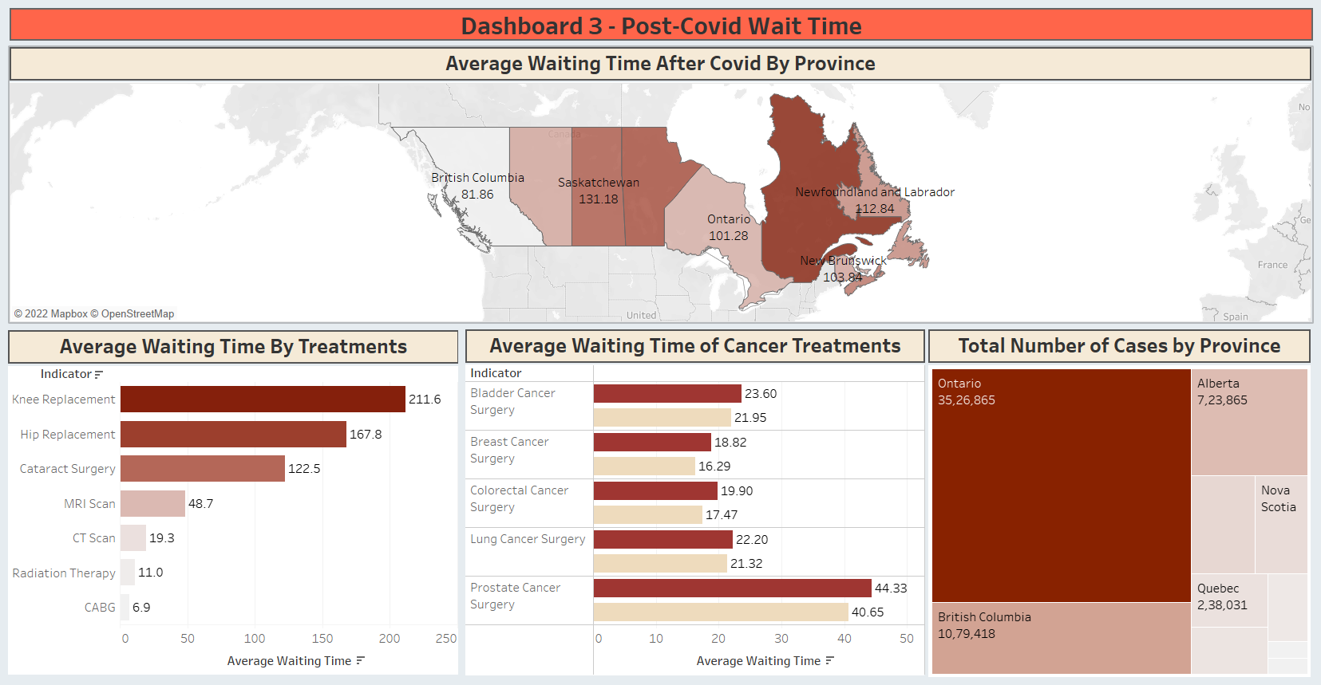

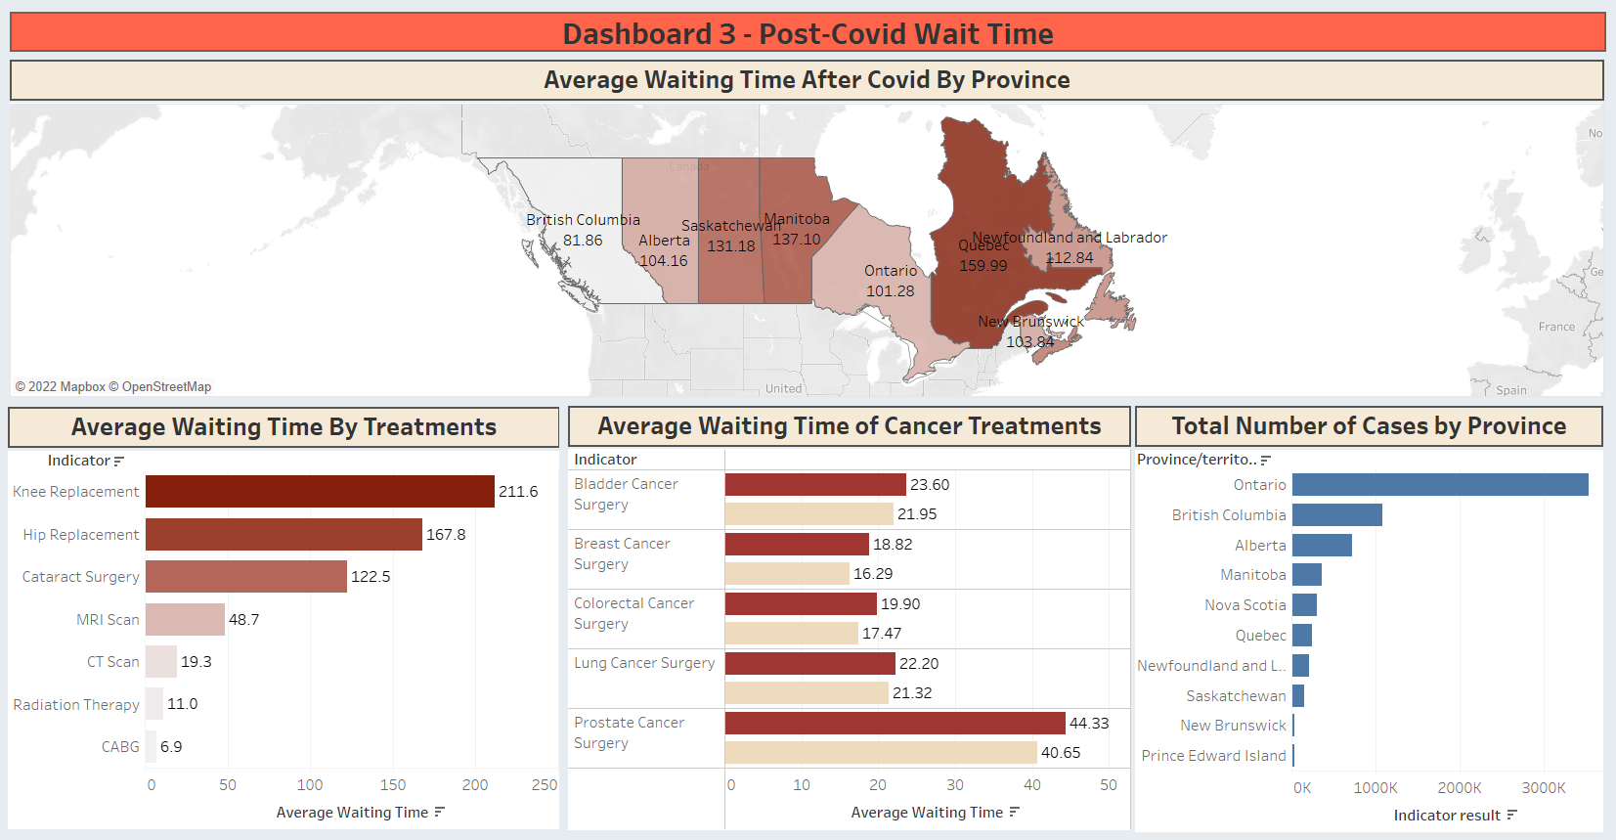

Slide 16
DASHBOARD 2 & 3 Comparison and INSIGHTS
Dashboard 3 discusses post-Covid insights, about wait times and we can see differences in wait times by province, the increase in averages of our priority treatments and the total number of cases in each province.
Alberta’s wait time average increased by 30.67 days
Manitoba’s wait time average increased by 34.11 days.
Ontario’s wait time average increased by 36.91 days.
Saskatchewan’s wait time average increased by 61.49 days.
Quebec’s wait time average increased by 75.77 days.
Nova Scotia’s wait time average only increased by 10.8 days.
British Colombia is the only province whose wait time average went down by 3.04 days.
Ontario, Alberta, British Colombia, Quebec and Nova Scotia are our top five provinces with the greatest number of cases, so we’ll be focusing on those provinces.

Slide 17
DASHBOARD 2 & 3 Comparison and INSIGHTS
Now here when we look at the total number of cases for each province in the post-Covid segment, we can see that the hierarchy has changed a bit since before Covid.
Before Covid, the hierarchy for the top 5 provinces with most cases was, Ontario, Alberta, British Colombia, Quebec and Nova Scotia and now after Covid, the hierarchy is, Ontario, British Colombia, Alberta, Manitoba and Nova Scotia.
So we can see that British Colombia in this whole project is the province of importance for us, because even with an increase in priority treatment cases post-Covid, the province was not only able to deal with this issue, they were able to actually decrease wait time averages, which is a huge achievement.
Although Nova Scotia is in the top 5 provinces with most number of cases, it still has had a significant less increase in wait time averages when compared to other provinces.
Considering the number of cases, Manitoba, Saskatchewan and Quebec had the highest increase in average wait times when looking at that ratio.

Slide 18
DASHBOARD 2 & 3 Comparison and INSIGHTS
Knee replacements, Hip replacements, cataract surgery, MRI scan and CT scan still remain the top 5 procedures with the highest wait times.
Knee replacements have had the highest increase post-Covid as well.
When looking at different cancer treatments, we can see that prostate cancer surgery is a cancer treatment with the most number of cases and highest average of wait times.
Based on all these insights we can say that –
British Colombia is the best province when it comes to keeping lower wait times for patients of high priority treatments.
Saskatchewan, Quebec and Manitoba are some of the worst provinces in maintaining average wait times when an increase in cases happens.
Ontario is a province where total number of cases and increase in cases has remained mostly consistent, which means that although it is an efficient province in maintaining average wait times with increase in cases, there are still multiple problems which need to be addressed.

Slide 19
Recommendations
Based on the insights collected in our project, we can give the following recommendations to improve the Canadian healthcare system and reduce wait time across multiple provinces –
Saskatchewan, Manitoba, Quebec and Ontario are provinces which have the worst wait times, they should adapt healthcare systems used in British Colombia to reduce average wait times for their provinces as well.
Scanning services such as MRI and CT are in high demand, but all provinces lack here, more centers for these need to be setup.
Prostate cancer and knee replacement treatment center’s need to be setup separately to address the huge issue of high average wait times.

Slide 20
Recommendations
Based on the insights collected in our project, we can give the following recommendations to improve the Canadian healthcare system and reduce wait time across multiple provinces –
Nova Scotia is a province where wait times have been the worst, even though number of cases have been low. It can be said that this province is the worst.

Slide 21

Thank You. Any questions?

